Slide 1
Introduction to Cryptocurrencies and Wallets
Grade 10+

Slide 2
A Special Note for Teachers

Slide 3
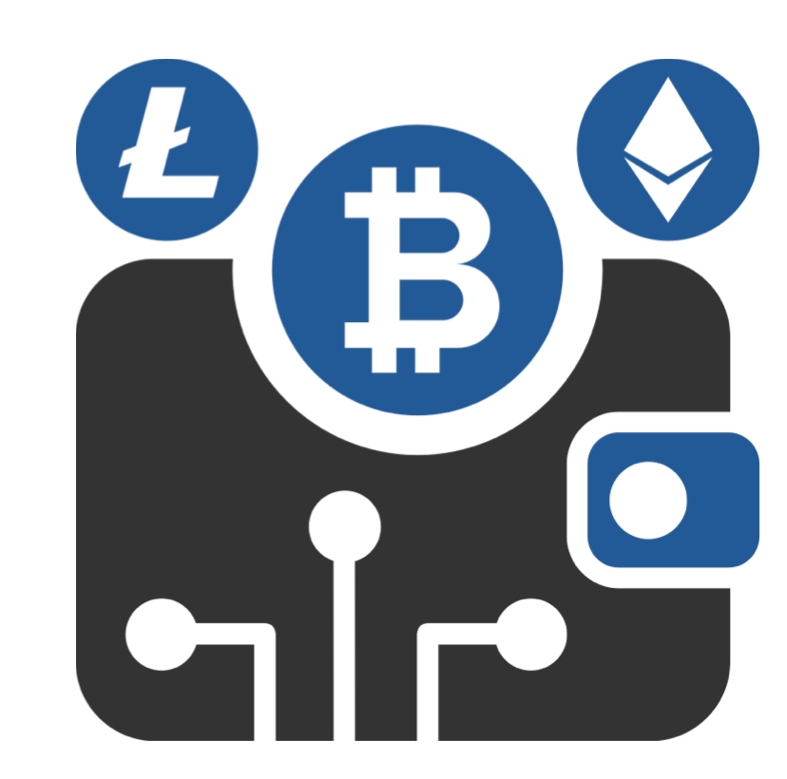
Students will Learn…
An introduction to cryptocurrency
Common types of cryptocurrencies
Benefits to using cryptocurrency
Risks of using cryptocurrency
How to set up a wallet
Different types of wallets

Slide 4
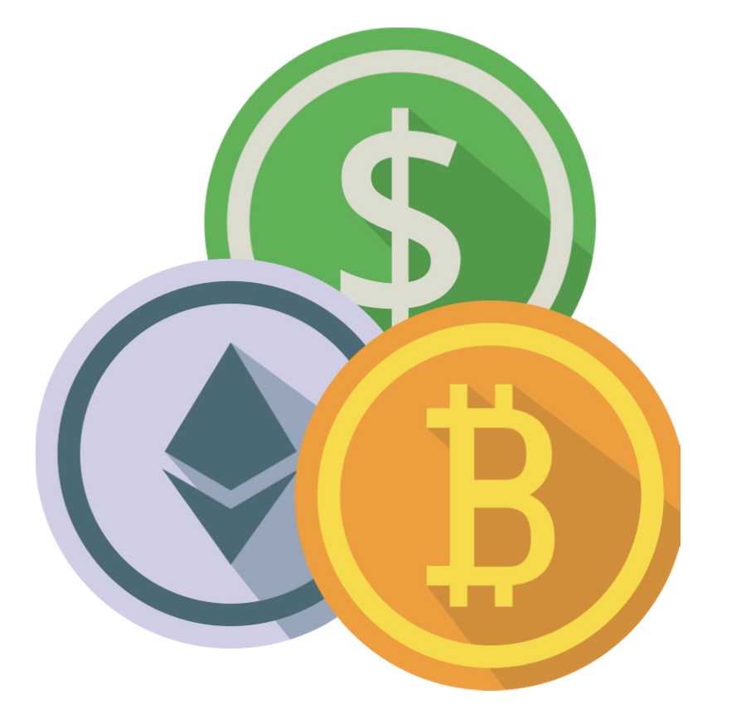
Welcome to Cryptocurrencies!
Cryptocurrencies are an up-and-coming asset class that many of you, and even your parents, have never used!
An asset is anything that is valuable or worth money.
There are many potential advantages to using cryptocurrency. It also comes with risks.

Slide 5
Welcome to Cryptocurrencies!
1) Cryptocurrency (or crypto for short) is a new asset which very few people in the world are using.
Think of it, how many people do you know are using it every day, or even own any at all?
As a new user, you are still at the beginning of a new technology.

Slide 6
Welcome to Cryptocurrencies!
2) You do not need to use a bank!
Many people do not have access to bank accounts for many reasons:
They're too young
They don't have enough I.D.
It's hard to access due to distance.
All you need for crypto is an internet connection.

Slide 7
Welcome to Cryptocurrencies!
3) There are a ton of upcoming job opportunities!
There are a variety of crypto-related jobs opening up, and very few people are qualified to apply for them. If you start early, you will be the cream of the crop.
You can also work from anywhere since many of these companies hire remote workers.

Slide 8
DANGER, DANGER! Risks ahead
Crypto is very risky. It is volatile and people have lost large amounts of money investing in it. Consider all of the risks before you go ahead with it.
Hacks are a very real threat.
It is very easy to fall victim to hacks or phishing attacks.
If you are hacked, you would lose your money without a way to get it back.
As a young person starting out you are a high risk of hackers.
You are responsible for your own safety
No one will protect you. There is no agency or company to report complaints.

Slide 9
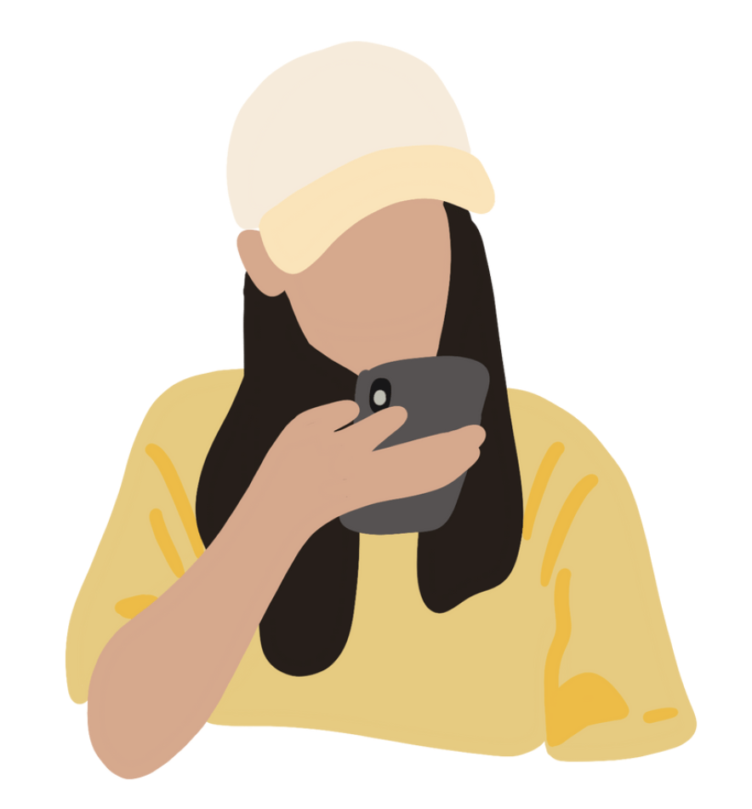
DANGER, DANGER! Risks ahead
Check out this article:
Are crypto and blockchain safe for kids, or should greater measures be put in place?

Slide 10
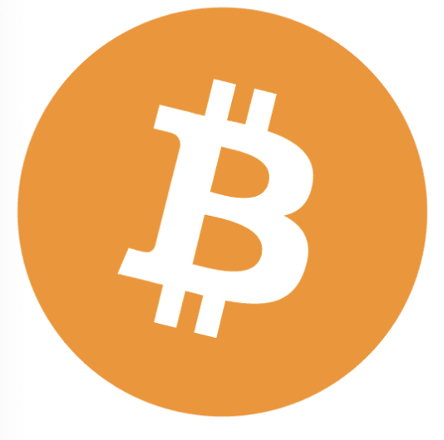
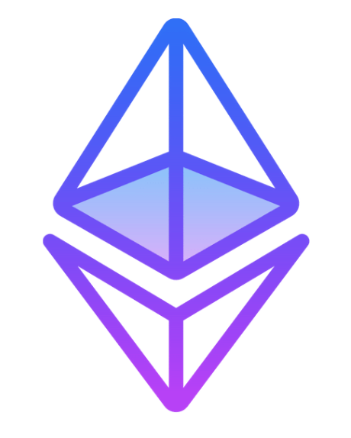
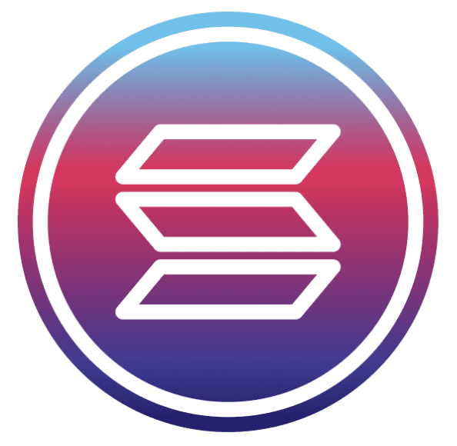
DANGER, DANGER! Risks ahead
There are different types of cryptocurrencies. Someone who buys crypto picks which one(s) to get. The oldest and most well-known is Bitcoin.
Here are a few examples:
Bitcoin
Ethereum
Solana

Slide 11
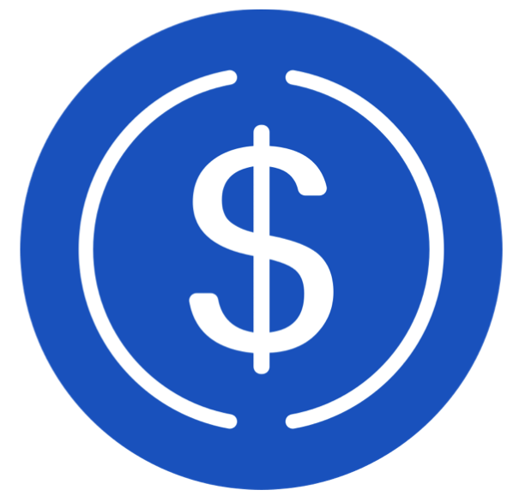
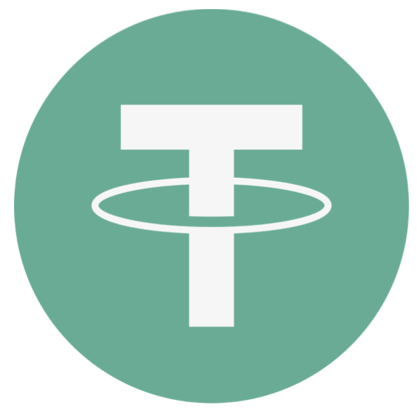
StableCoin Examples
As a response to the volatility, there are some cryptocurrencies that are kept at the same rate as regular money. This can make them safer places to store your money.
Here are two examples that are the kept the same rate as the U.S. dollar:
USD Coin
Tether

Slide 12
Let’s Get Started: Using a Wallet
What is a crypto wallet?
Each individual cryptocurrency has two parts: A wallet and a blockchain.
A blockchain is used to buy and a wallet to store crypto.
Here are some examples:
Wallet | Blockchain
Metamask | Ethereum
Phantom | Solana
Atomic | (Multiple blockchains)

Slide 13
Let’s Get Started: Using a Wallet
Wallet types: Which is the safest? Research the three wallet types, define them, and learn which is the safest for storing your assets.
Type of Wallet | Advantages | Disadvantages
Exchange wallets
Hot wallets
Cold wallets
Paper wallets

Slide 14
Setting up a Wallet
Your storage phrase are 12 words you memorize to access your wallet.
Which is the most secure strategy for storing your 12 word storage phrase?
Discuss the pros and cons of each of the following strategies:
Security Strategy | Pros | Cons
1.Using a security manager.
2. Writing down on a piece of paper.
3. Memorizing the security phrase

Slide 15
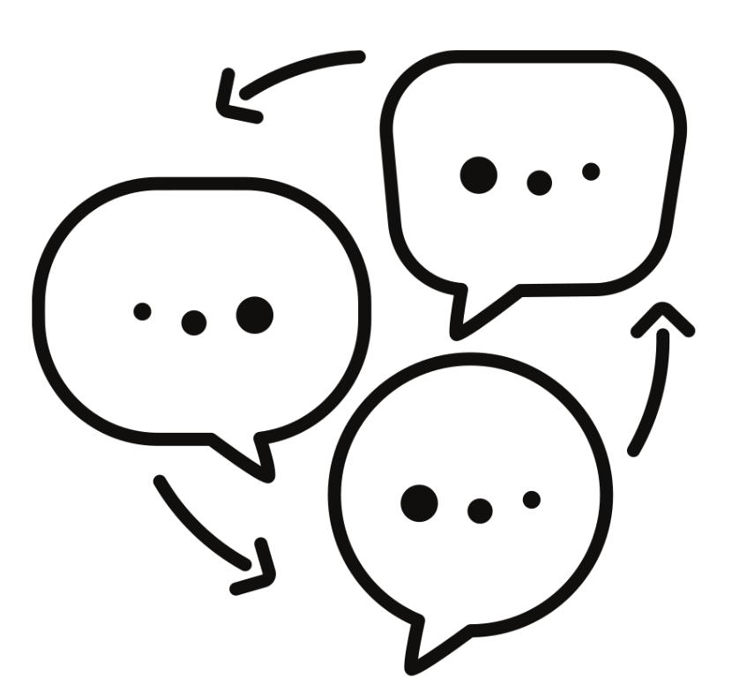
Reflection
What are some reasons someone might decide to invest in crypto?
What are some things that could go wrong?
Are there any advantages to storing money in a Stablecoin instead of a bank?
What are some steps to stay safe while investing in crypto?

Slide 16
Resources
Websites:
Cryptocurrency Teens: Started by a teenager to debunk inaccurate or misleading information about crypto.
Wallets:
http://metamask.io/
Nami (namiwallet.io)
Phantom - A friendly Solana wallet built for DeFi & NFTs
Atomic Wallet - Buy, Stake and Exchange in One Crypto Wallet
Safe & Secure Desktop Crypto Wallet for Windows, Mac & Linux | Exodus
Youtube:
MetaMask Tutorial for Beginners - How to Set Up MetaMask – YouTube
TOP Crypto Security TIPS!! DON'T Make These Mistakes!! 🔐 - YouTube

